Slide 1
April 11, 2019
Piscataqua River Bridge
SPS Corporate Management Meeting

Slide 2
Agenda
Project Scope
Construction Schedule and Maintaining Traffic
Site Photos

Slide 3
Project Purpose
Preventative maintenance
Improve traffic flow at peak volumes
Improve safety

Slide 4
Who is Involved?

Slide 5
Project Timeline
Project Advertised November 2018
Bid Opening January 2019
Project Awarded to SPS NE March 2019
Substantial Completion October 2021
Final Completion May 2022

Slide 6
Project Scope

Slide 7
Project Scope

Slide 8
Project Scope
Traffic Control
Access to work locations
Asphalt wearing surface replacement
Bridge deck and substructure repairs
Joint replacement
Fascia & median barrier replacement

Slide 9
Project Scope
Bridge drainage replacement
Zinc Anode Systems
Electrical system upgrade
Maine approach work to Exit 3 NB

Slide 10
Existing Railing & Median Barrier

Slide 11
New Fascia & Median Barrier

Slide 12
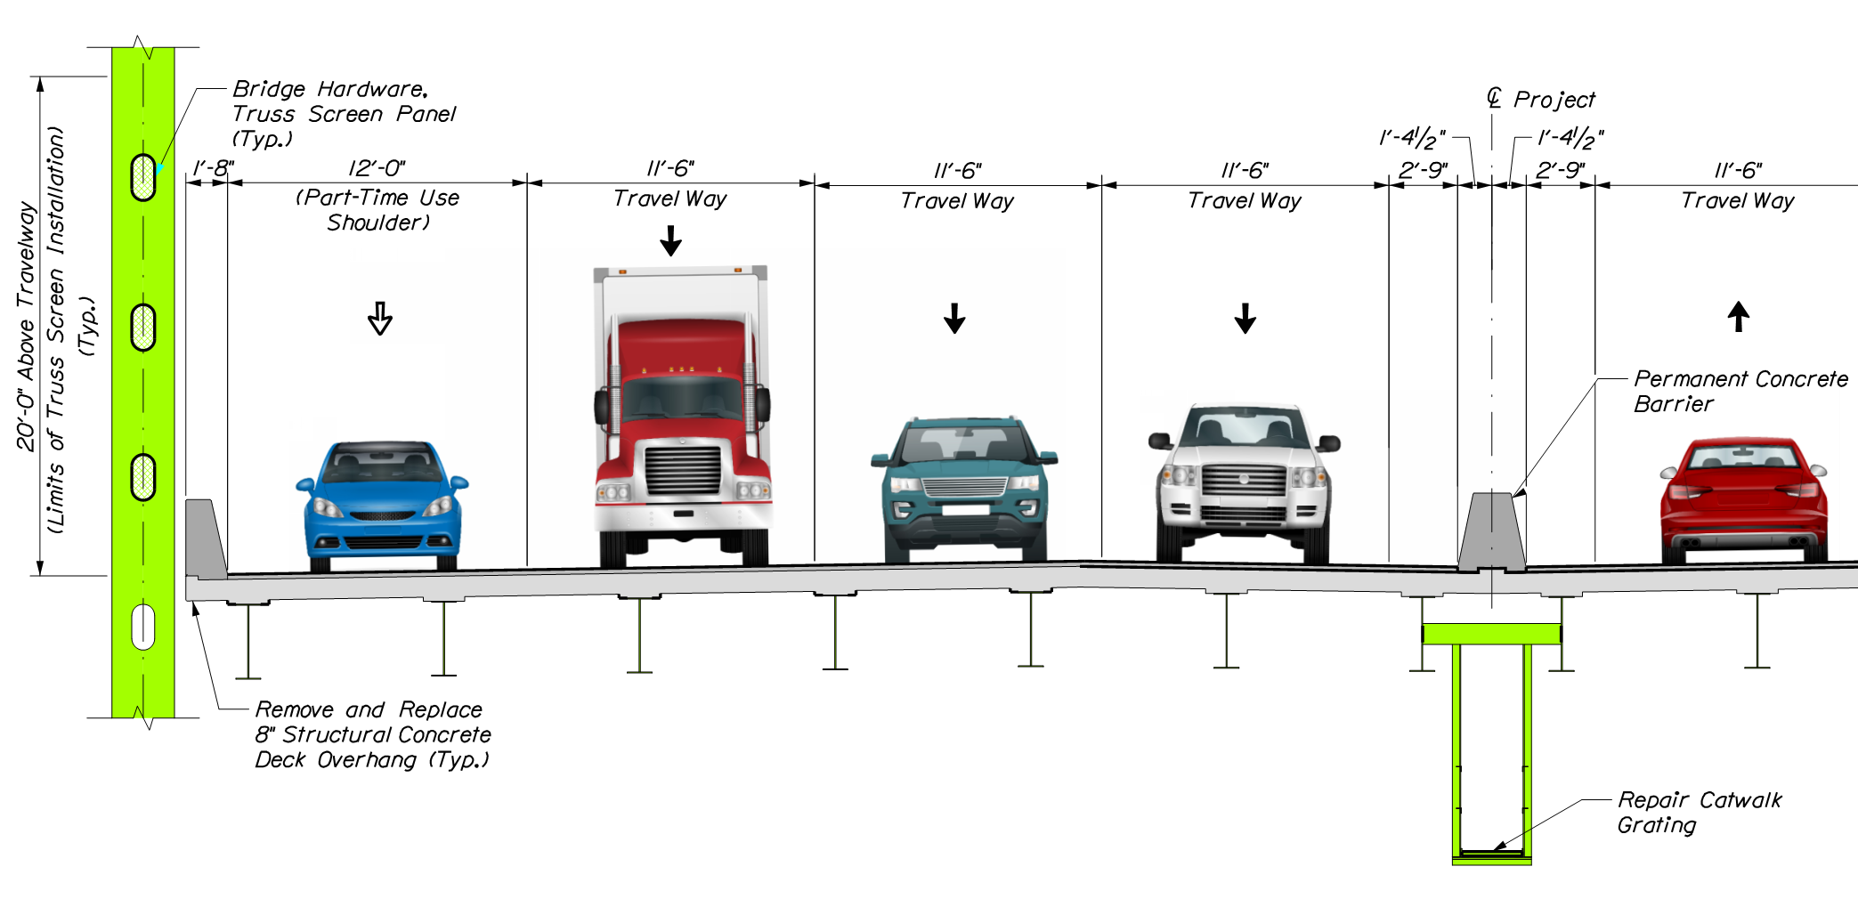
Part-Time Shoulder Use

Slide 13
Construction Scheduling & Maintaining Traffic

Slide 14
Construction Schedule
Beginning in June 2019
Substantial Completion October 1, 2021
Contract Completion May 20, 2022
Substantial Completion Incentives
Contract Completion Incentives

Slide 15
Proposed Construction Schedule
Southbound Fascia – 2019-2020
Northbound Fascia - 2020
NB & SB Median - 2021
Final Pave - Spring 2022

Slide 16
Maintaining Traffic
“Peak” - 3 lanes open for summer traffic
Daytime, Memorial Day to Columbus Day
Work in shoulders w/ lane shifts
“Non-Peak” – 2 lanes open
Daytime, Columbus Day to Memorial Day
3 lane Incentives – NB on Fri/Sat and SB Sun
Nighttime extra lane closures: 7pm – 6am

Slide 17
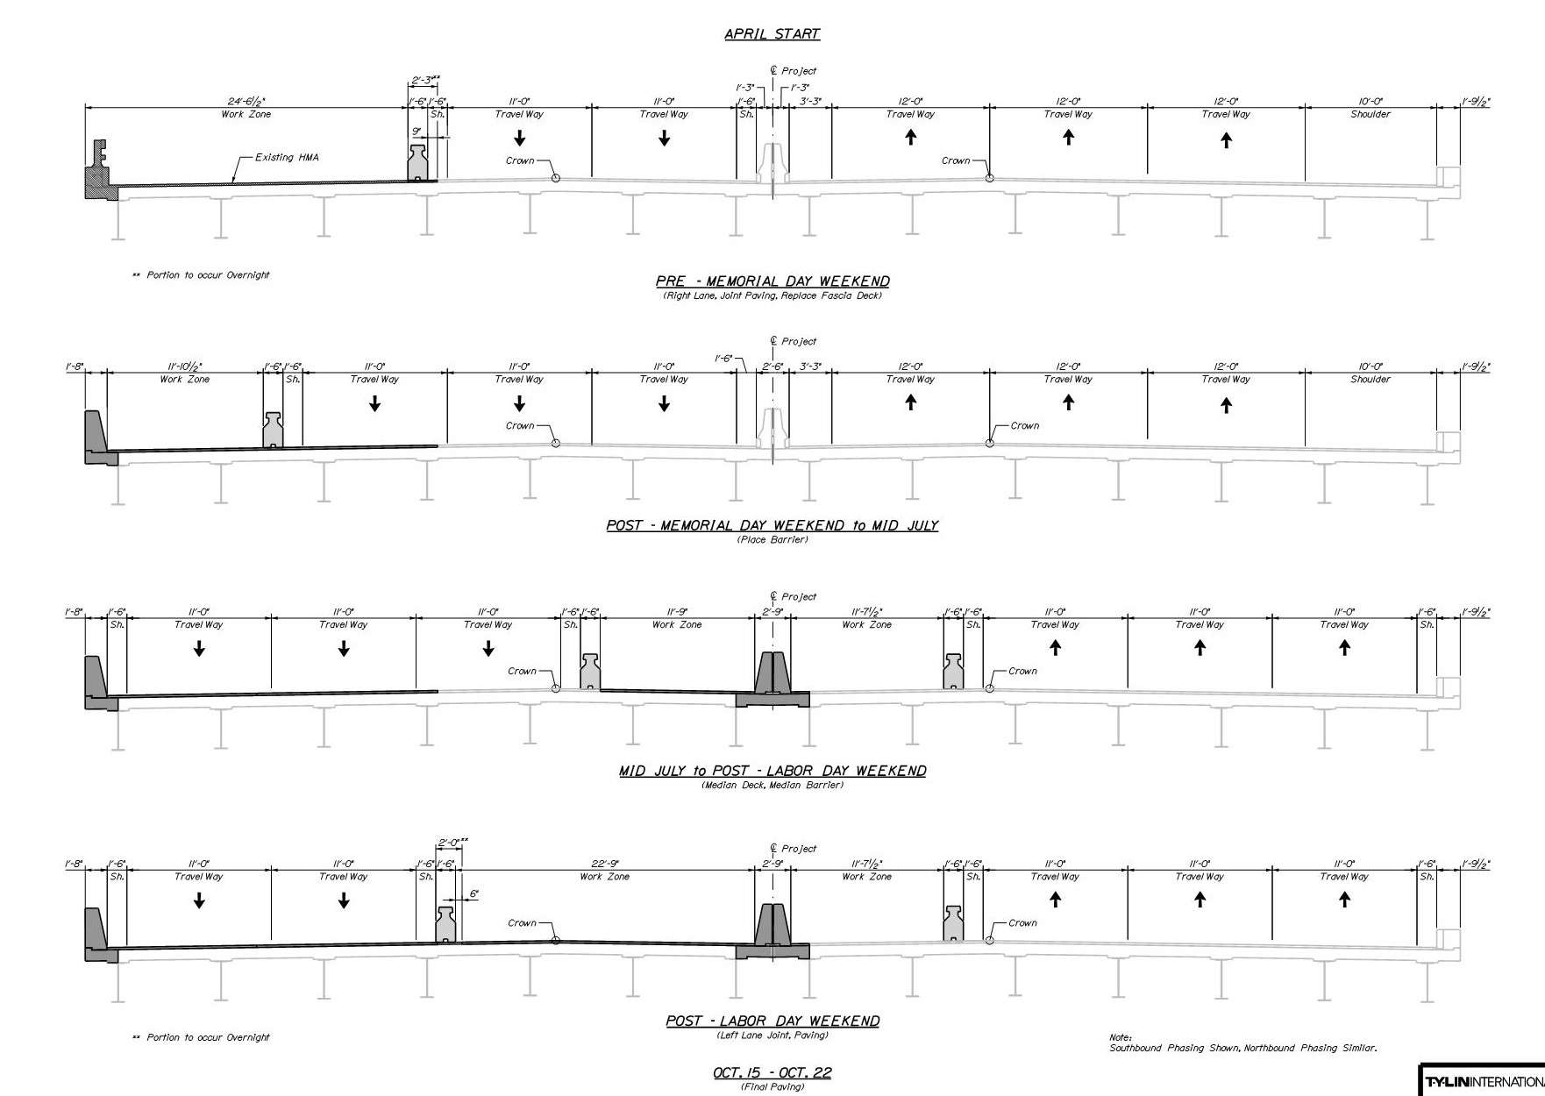
Non-Peak (Fascia Lane)
Peak (Fascia Shoulder)
Peak (Median Shoulder)
Non-Peak (Median Lane)

Slide 18
Site Photos

Slide 19
Site Photos

Slide 20
Site Photos

Slide 21
Site Photos

Slide 22
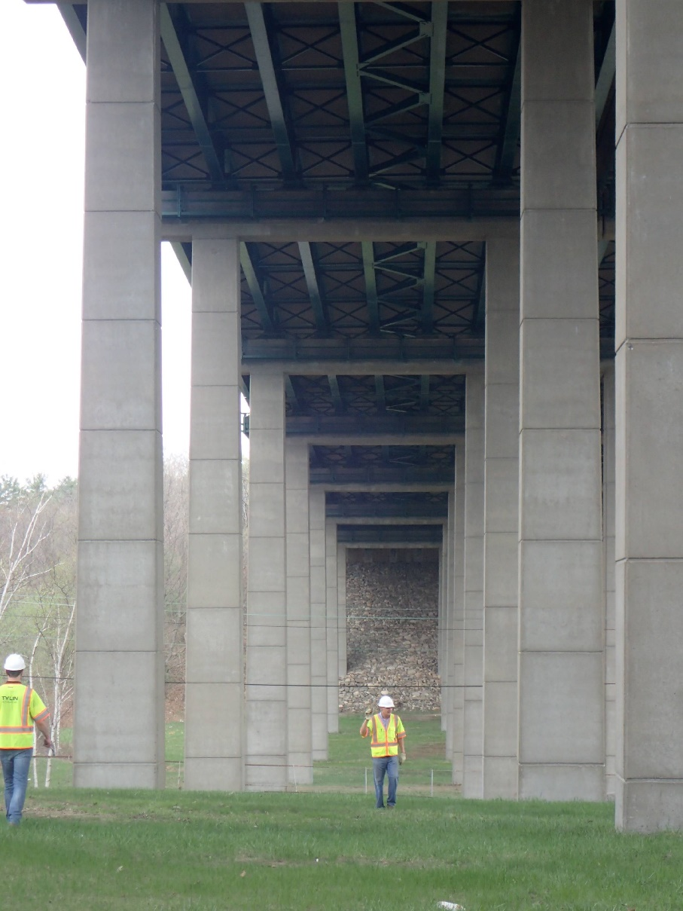
Site Photos

Slide 23
Site Photos

Slide 24
Site Photos

Slide 25
Site Photos

Slide 26
Site Photos

Slide 27
Site Photos

Slide 28
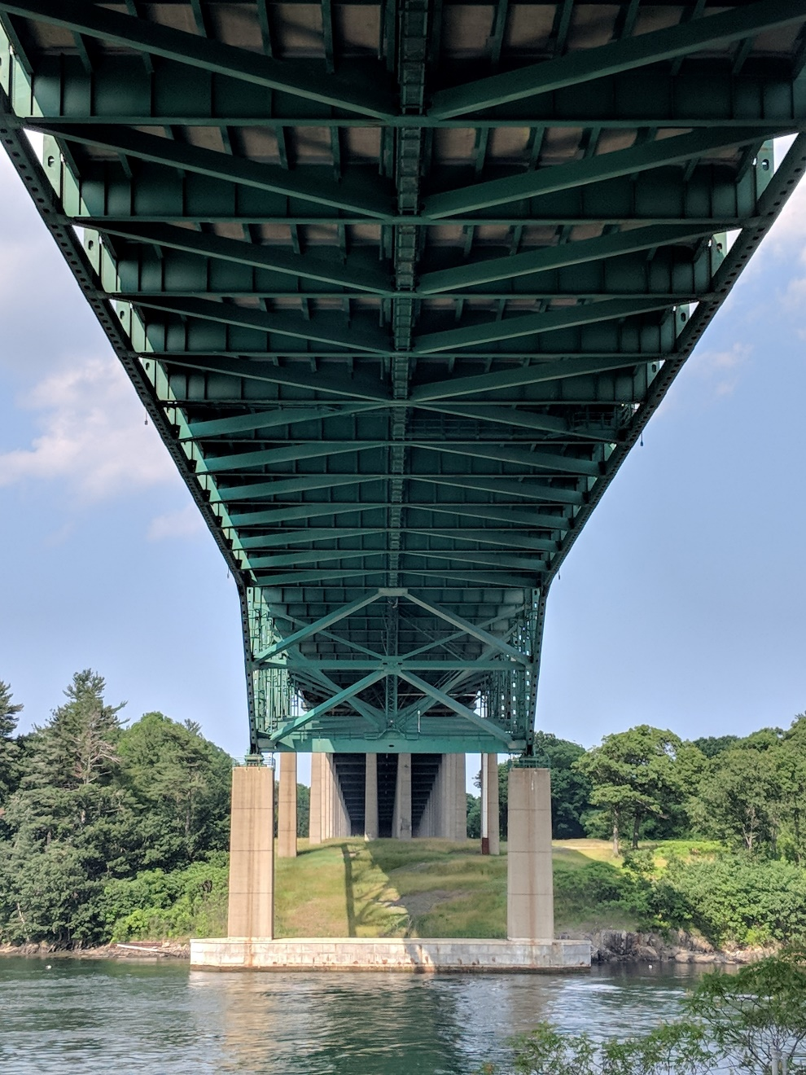
Questions?

